Slide 1

Eastern Ridge Church App
Danielle DeSilvio
October 26, 2025
CST-391
Notes:
Hello, I’m Danielle Desilvio and I’m going to present the application I have developed.
Note that the React version of the application is the most developed version of the application, in addition to being compatible with the current version of the API, so that is the one I will cover.

Slide 2
Objectives
Provide users a way to keep up with weekly sermons
Summaries
Worship songs
Verses
Notes:
The Eastern Ridge Church app is a web application for a hypothetical small church that aims to keep its members up to date with their weekly sermons. Using the web application, users can access each individual sermon and view information associated with it. This includes any applicable summaries and notes, as well as songs sung in the worship service and verses referenced in the sermon.

Slide 3
Development Challenges & Remaining Issues
Handling states in a proper manner
How they interact with useEffect()
Child Routes
The home page is not finished
Notes:
The greatest challenge in developing this application was understanding how React states work, particularly in regards to useEffect(). SetState() calls are asynchronous, so trying to access associated variables right away will not yield the results one might expect. This is why it is important to utilize useEffect() when states are changed so that other variables and components can respond to the change accordingly.
It also took a while to set up child routing (used in the Administrator dashboard setup) without encountering errors, only since I did not understand how it worked at first.
As for remaining issues, while it was not strictly required, the home page is not finished due to severe time restraints.

Slide 4
Lessons Learned
How JavaScript frameworks are utilized in the technology stack
Interacting with REST APIs
Providing users with a responsive website design
TypeScript
Transferrable since it is used in other frameworks as well
Notes:
The main lesson I as a student developer learned from making this application was how React and Angular works to deliver a responsive application to users, utilizing data retrieved via REST APIs. Acting as both the front-end and the back-end, they are powerful tools that have been used in the development of many large-scale enterprise applications.
TypeScript was not something I was familiar with, though since it only builds upon JavaScript by adding types, it was not difficult to learn and adjust to. The knowledge and skills are transferrable, since TypeScript is also used in other JavaScript frameworks.

Slide 5
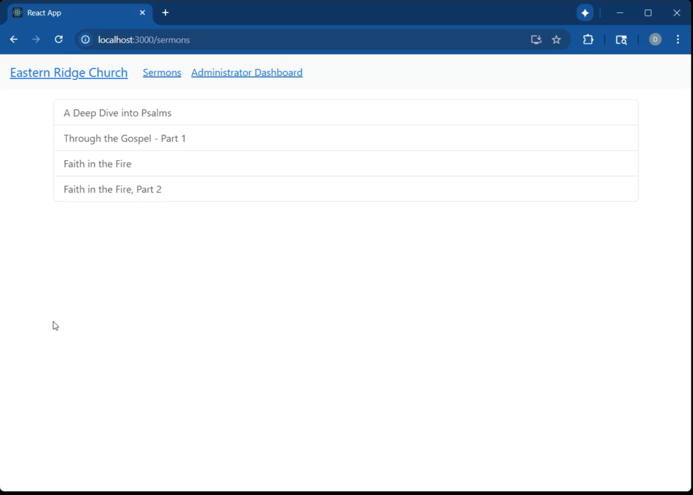
Application: SERMON CRUD OPERATIONS
Notes:
Here are the CRUD operations for Sermons.

Slide 6
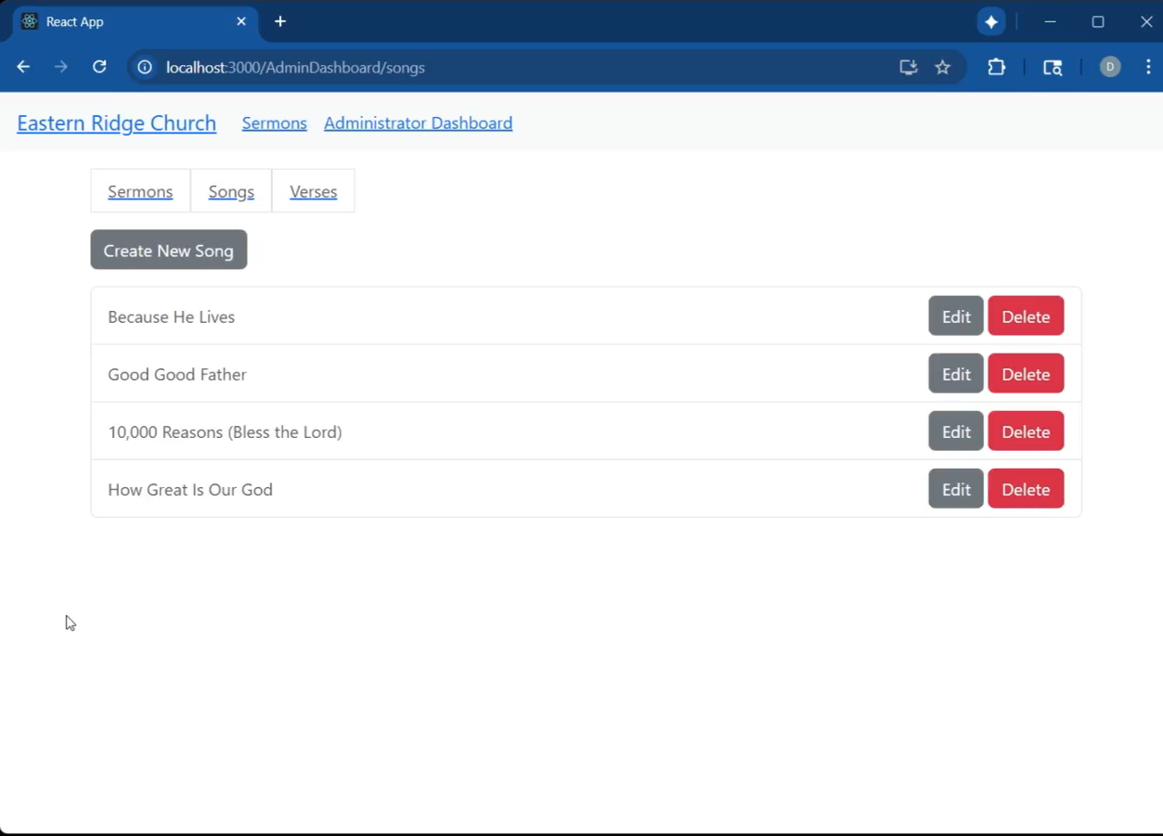
Application: SONG CRUD OPERATIONS
Notes:
Here are the CRUD operations for Songs.

Slide 7

Application: VERSE CRUD OPERATIONS
Notes:
Here are the CRUD operations for Verses.

Slide 8
Website accessibility from a Christian perspective
Practicing hospitality is a duty of the church, and of all Christians
Scripture emphasizes the importance of caring for the vulnerable: “the least of these” (Matthew 25:35-40)
Providing means of access promotes human dignity
Best practices:
Alternate text: used by screen-readers for visually-impaired users
High-contrast colors for visually-impaired users
Keyboard navigation for users with motor disabilities
Notes:
Website accessibility is an

